Slide 1

Chapter 15
Transmission
Control
Protocol
(TCP)
TCP/IP Protocol Suite
Copyright © The McGraw-Hill Companies, Inc. Permission required for reproduction or display.

Slide 2
15-9 CONGESTION CONTROL
We discussed congestion control in Chapter 13. Congestion control in TCP is based on both open loop and closed-loop mechanisms. TCP uses a congestion window and a congestion policy that avoid congestion and detect and alleviate congestion after it has occurred.
TCP/IP Protocol Suite

Slide 3
Topics Discussed in the Section
Congestion Window
Congestion Policy
TCP/IP Protocol Suite

Slide 4
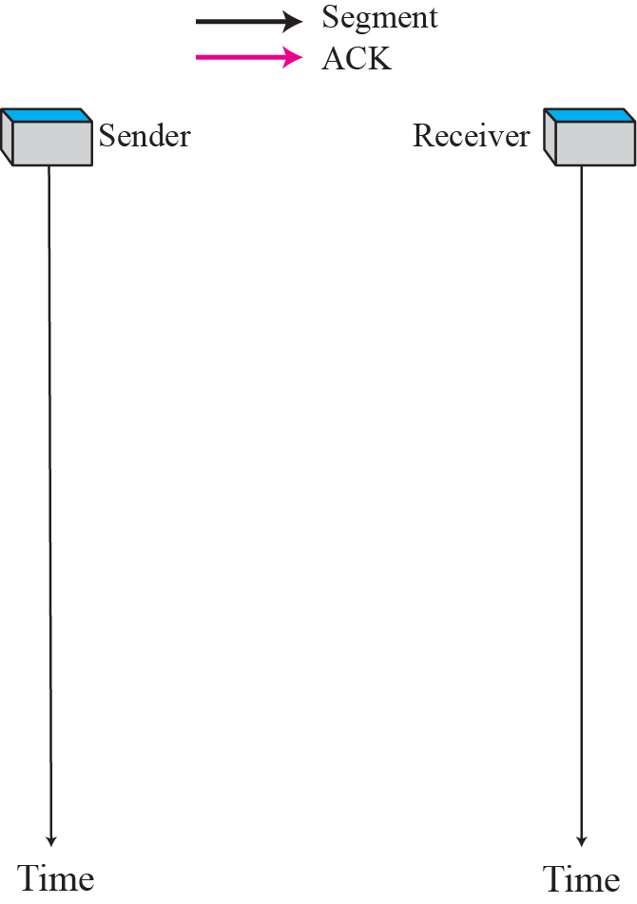
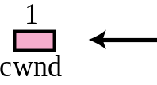
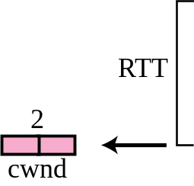
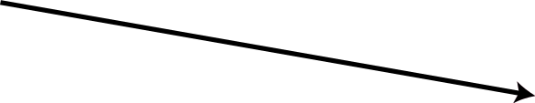

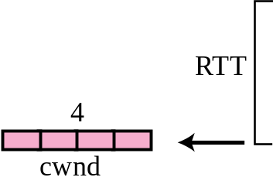
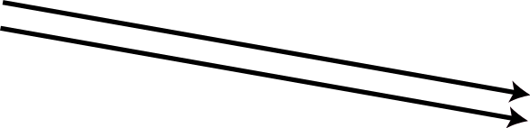
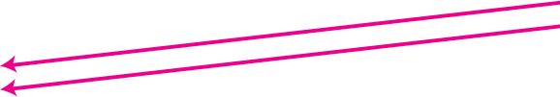

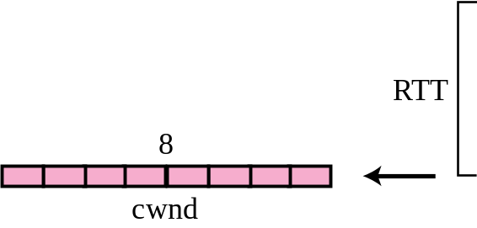

Figure 15.34 Slow start, exponential increase
TCP/IP Protocol Suite

Slide 5

Note
In the slow start algorithm, the size of the congestion window increases exponentially until it reaches a threshold.
TCP/IP Protocol Suite

Slide 6
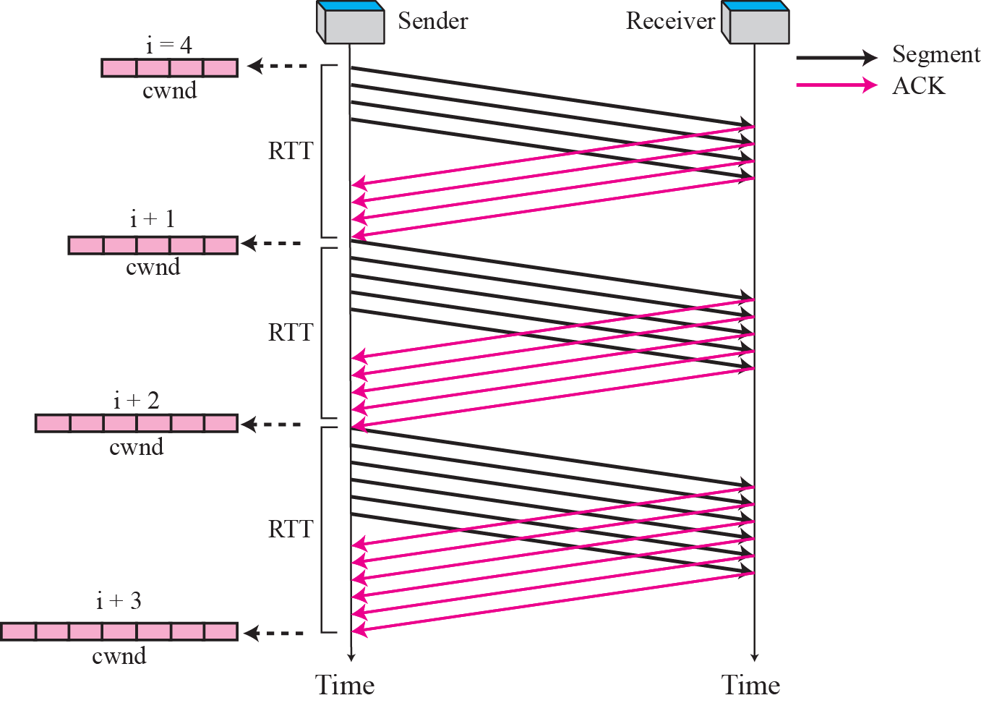
Figure 15.35 Congestion avoidance, additive increase
TCP/IP Protocol Suite

Slide 7
Note
In the congestion avoidance algorithm the size of the congestion window
increases additively until
congestion is detected.
TCP/IP Protocol Suite

Slide 8
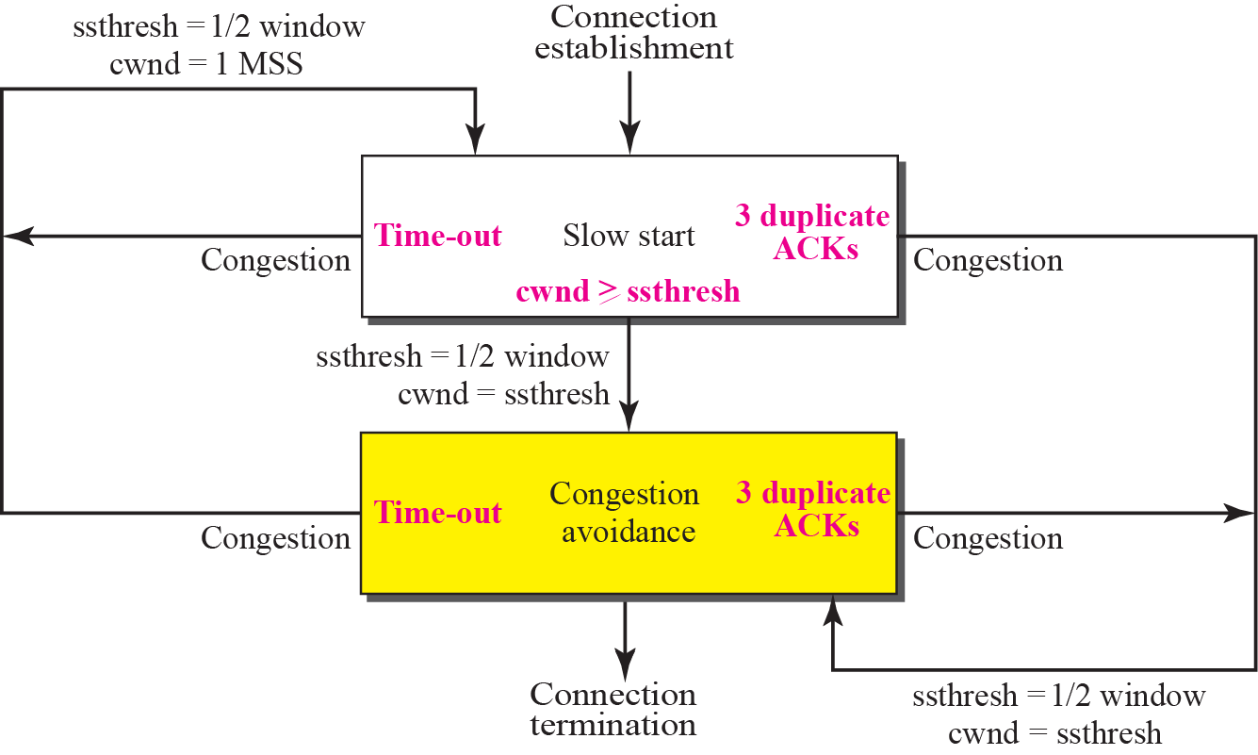
Figure 15.36 TCP (Reno&NewReno) Congestion policy summary
TCP/IP Protocol Suite

Slide 9
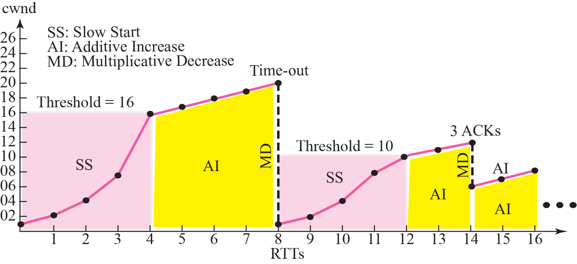
Figure 15.37 Congestion example (Reno&NewReno)
TCP/IP Protocol Suite

Slide 10
TCP Congestion Control evolution (ADVANCED)
First versions
No fast retransmit (3dupacks) only timeouts
Tahoe
Fast Retransmit (3dupacks) with cwnd=1
Reno (RFC 5681)
Fast Retransmit/recovery with cwnd=ssthresh
Recovery ends at reception of the ACK confirming the first retransmitted segment
NewReno (RFC 6582)
Recovery end delayed until reception of the «full» ACK, confirming the last segment sent before entering recovery (e.g. all outstanding data)
It avoids multiple halving of cwnd in the presence of burst of losses (multiple losses among the outstanding segments), frequent in radio channels
Recovery with SACK (RFC 6675)
At least 10 «experimental» variants in Linux, included Cubic (and Hybla)
PRR Proportional Rate Reduction (RFC 6937)
It is patterned after Rate-Halving (1 packet sent every 2 dupacks in recovery), but using the fraction that is appropriate for the target window chosen by the congestion control algorithm (not 50% in Cubic).

Slide 11
TCP Tuning
There are some (actually, >50 in Linux!) TCP related parameters that can be configured to improve performance
To see all: sysctl -a|grep ipv4.tcp|more
advanced-tuning-for-linux by NASA

Slide 12
15-10 TCP TIMERS
To perform its operation smoothly, most TCP implementations use at least four timers as shown in Figure 15.38 (slide 83).
TCP/IP Protocol Suite

Slide 13
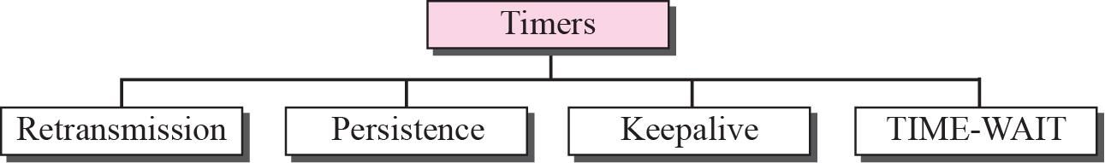
Figure 15.38 TCP timers
TCP/IP Protocol Suite

Slide 14
15-11 OPTIONS
The TCP header can have up to 40 bytes of optional information. Options convey additional information to the destination or align other options. We can define two categories of options: 1-byte options and multiple-byte options. The first category contains two types of options: end of option list and no operation. The second category, in most implementations, contains five types of options: maximum segment size, window scale factor, timestamp, SACK-permitted, and SACK (see Figure 15.41).
TCP/IP Protocol Suite

Slide 15
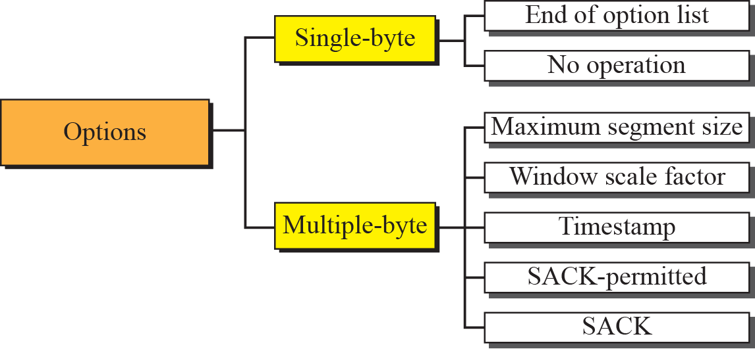
Figure 15.41 Options
TCP/IP Protocol Suite

